Slide 1
A* Optimzations Research
Sebastià López Tenorio

Slide 2
The problem
A*

Slide 3
Possibilities

Slide 4
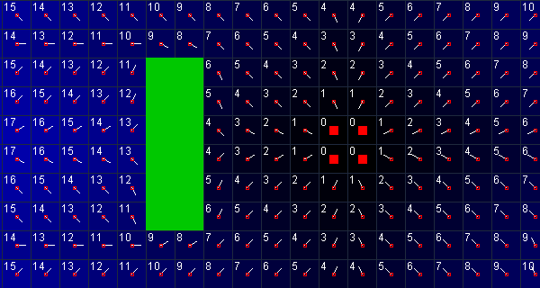
Potential fiels

Slide 5
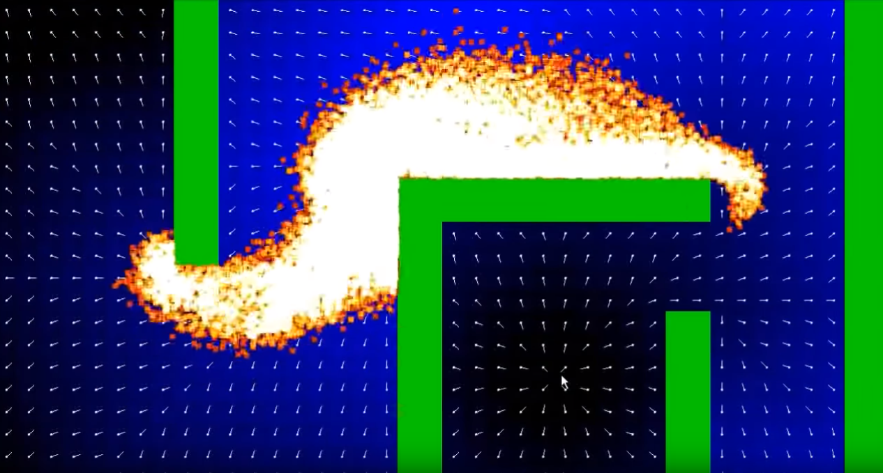
Potential fiels

Slide 6
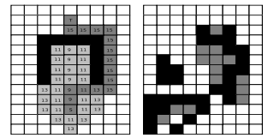
Swamps

Slide 7
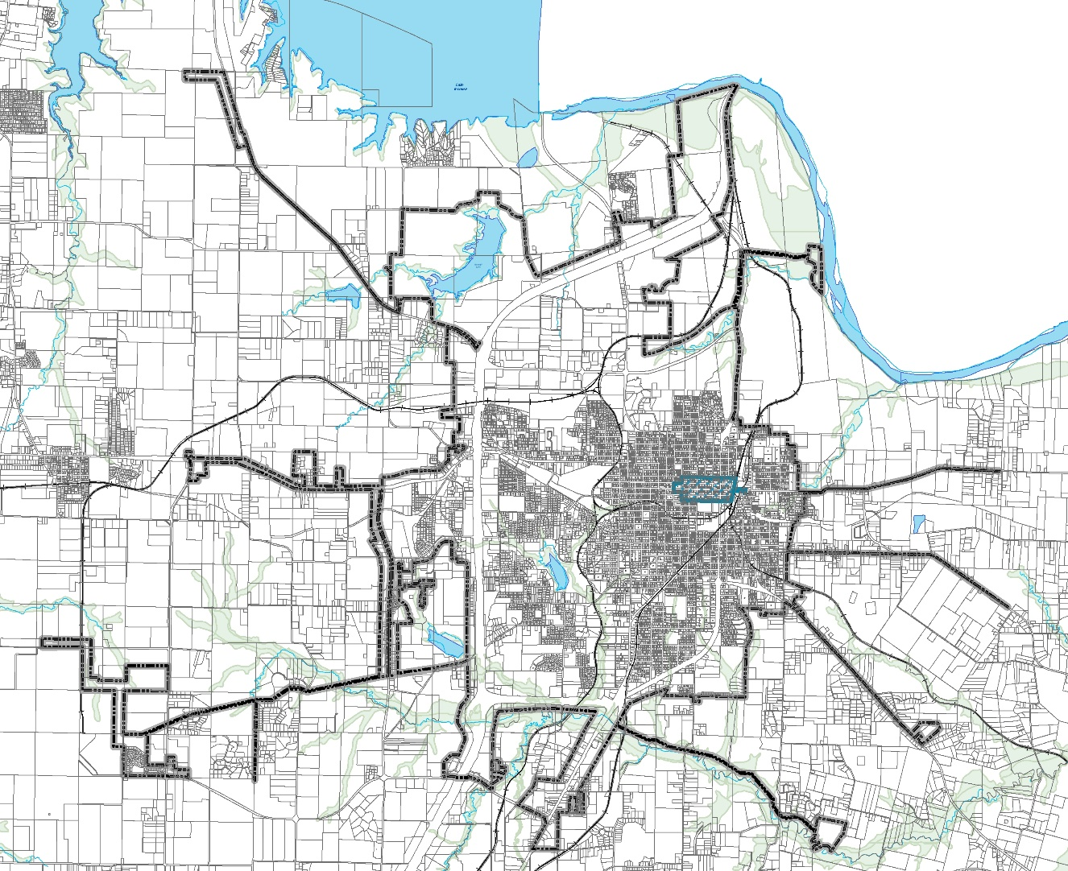
hierarchical pathfinding

Slide 8
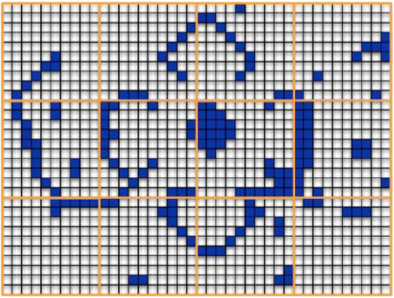
HPA*

Slide 9
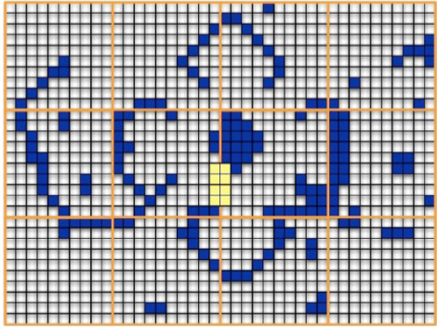
HPA*

Slide 10
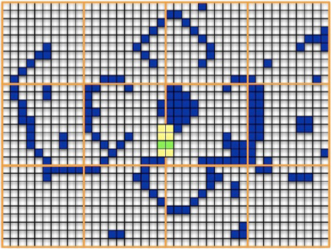
HPA*

Slide 11
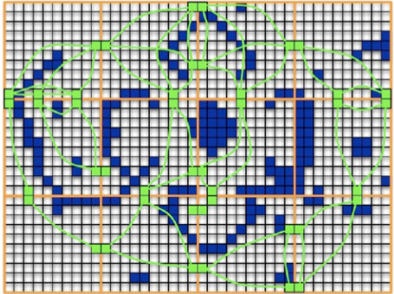
HPA*

Slide 12
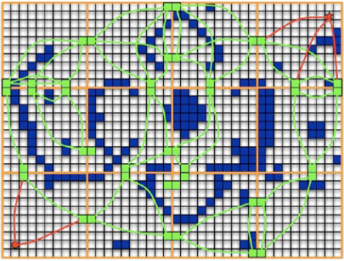
HPA*

Slide 13
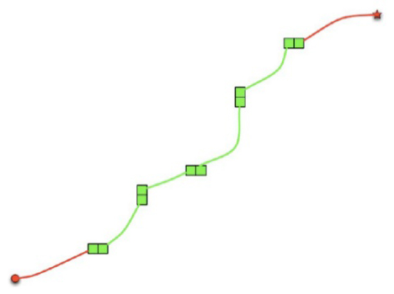
HPA*

Slide 14
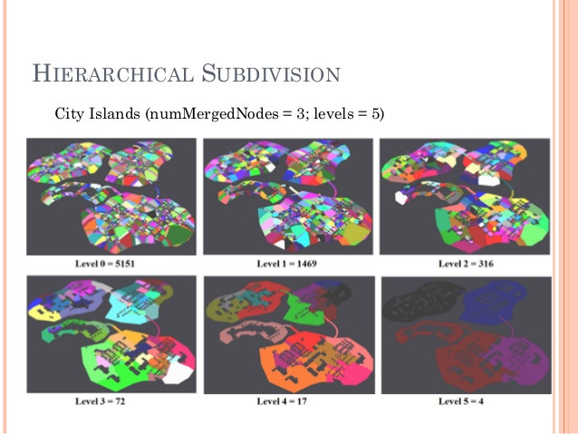
HPA*

Slide 15
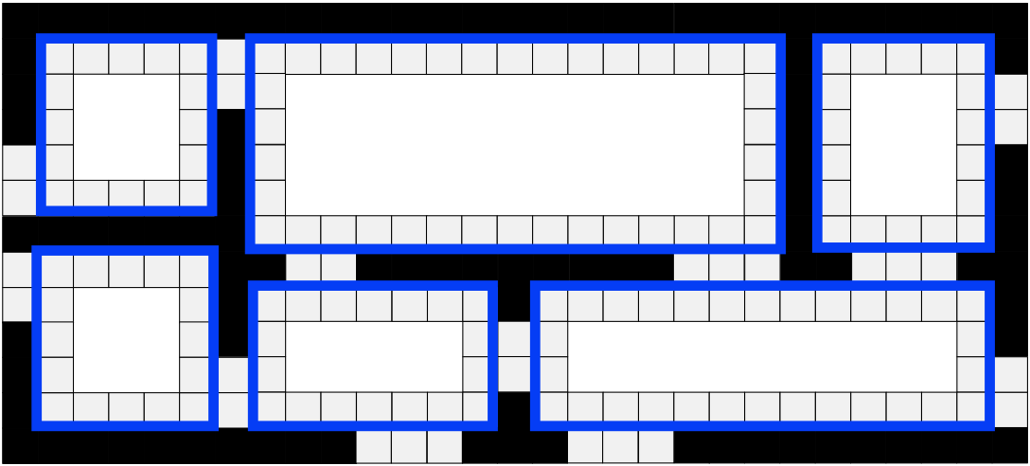
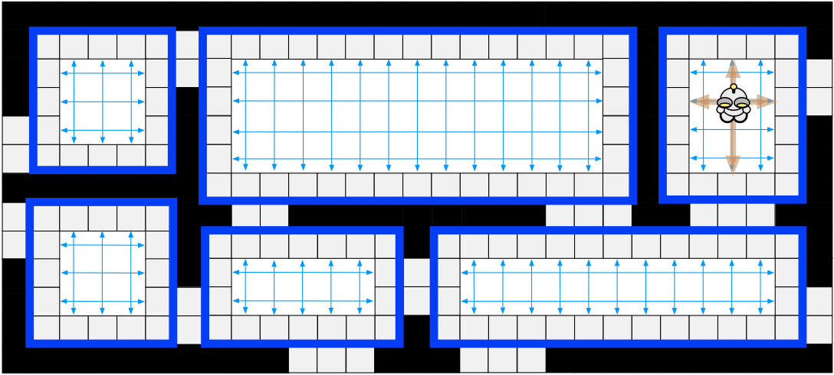
RSR

Slide 16
Selected approach

Slide 17

Jump point search

Slide 18
overview
Online
Incredibly Fast
Can be easily adapted with other improvement Algorythms
Only works with uniform-cost grids

Slide 19

objective

Slide 20
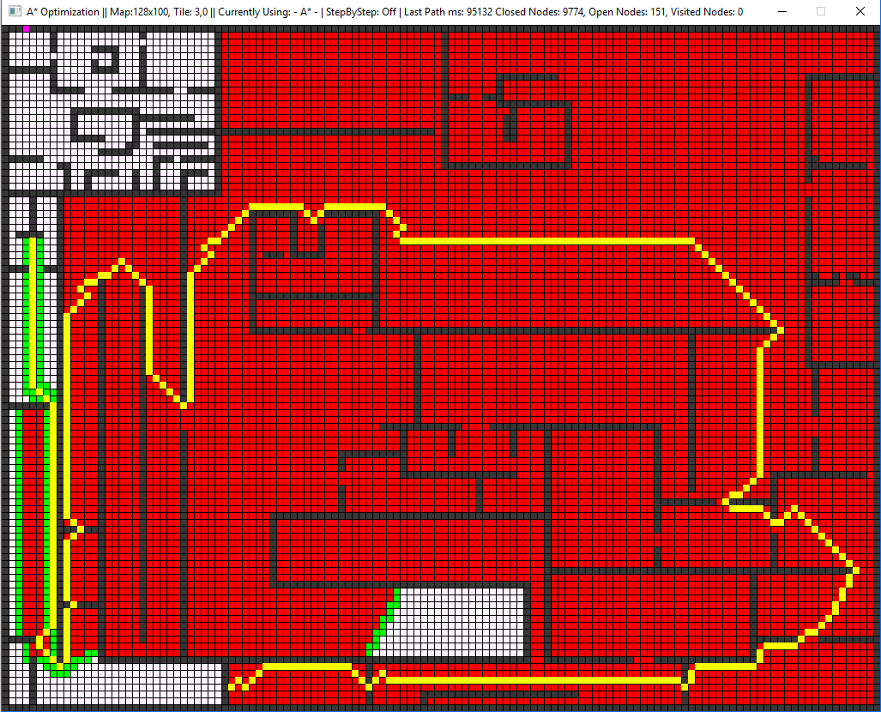
objective

Slide 21
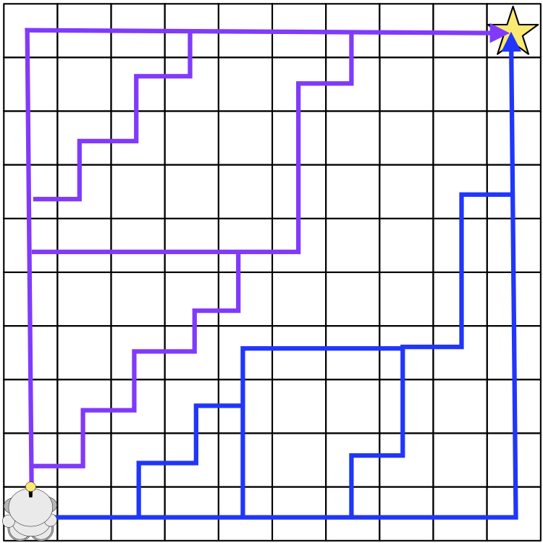
Path symmetry

Slide 22
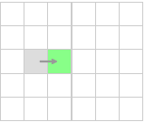
Horizontal jump

Slide 23
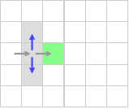
Horizontal jump

Slide 24
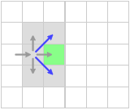
Horizontal jump

Slide 25
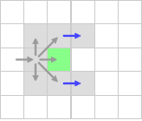
Horizontal jump

Slide 26
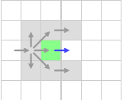
Horizontal jump

Slide 27
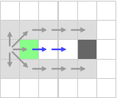
Horizontal jump

Slide 28
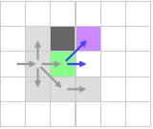
Horizontal jump – forced neighbour

Slide 29
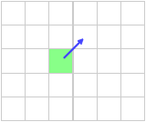
Diagonal jump

Slide 30
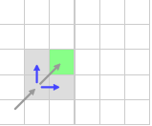
Diagonal jump

Slide 31
Diagonal jump

Slide 32
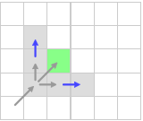
Diagonal jump

Slide 33
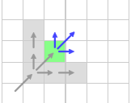
Diagonal jump

Slide 34
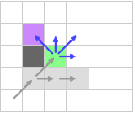
Diagonal jump - – forced neighbour

Slide 35
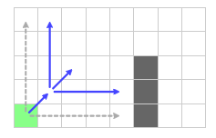
Iteration

Slide 36
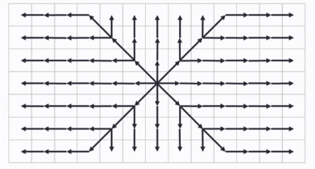
Iteration

Slide 37
Iteration
JPS == A*

Slide 38
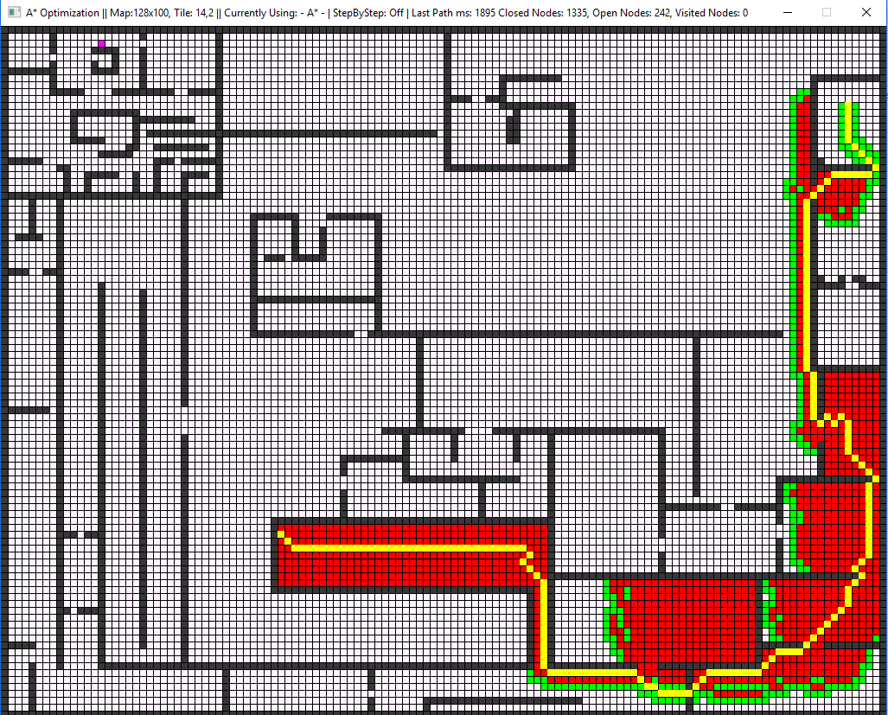
Performance

Slide 39
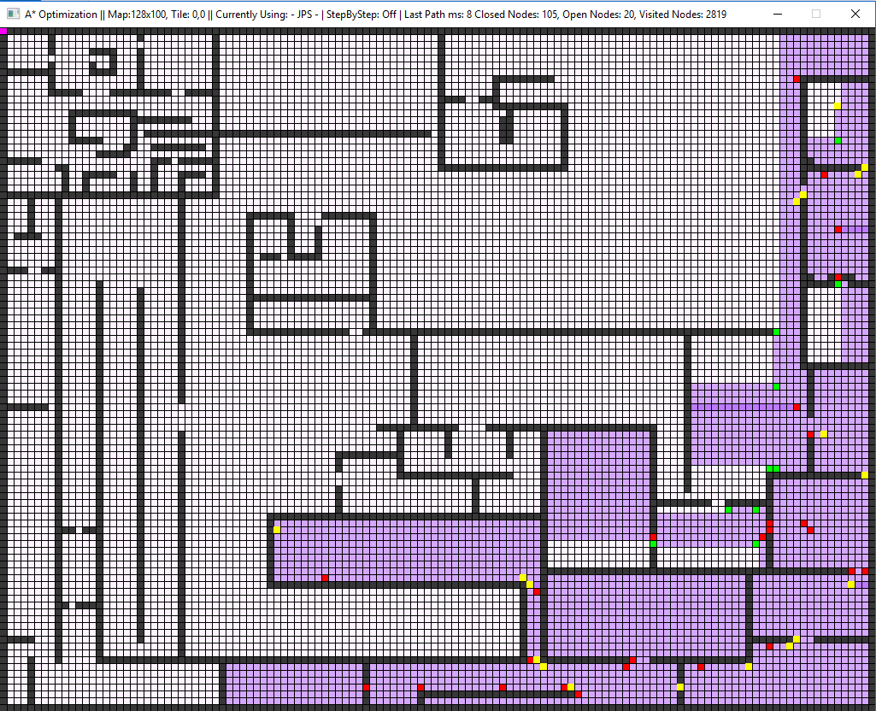
performance

Slide 40
Performance

Slide 41
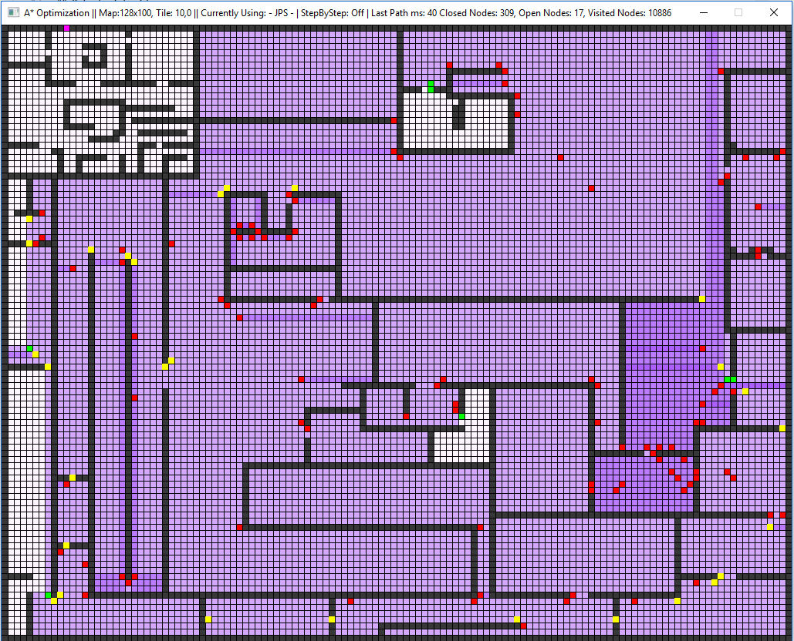
performance

Slide 42
Disclaimer!
this->JPS != JPS

Slide 43
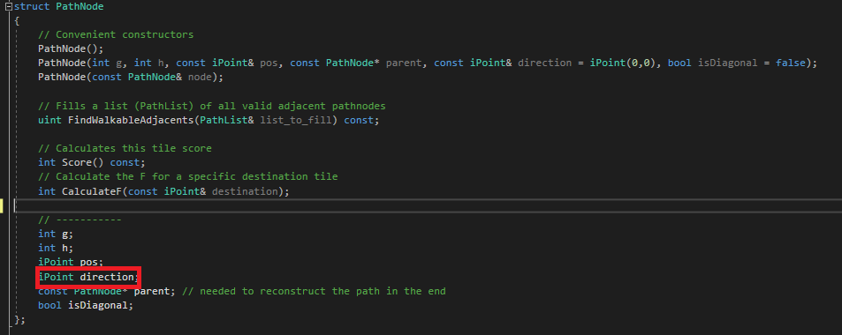
implementation

Slide 44
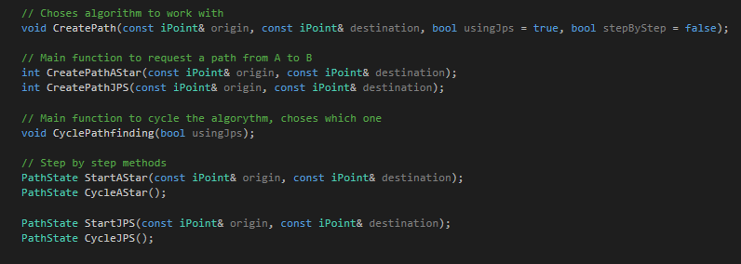
implementation

Slide 45
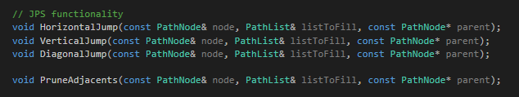
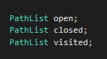
Implementation

Slide 46
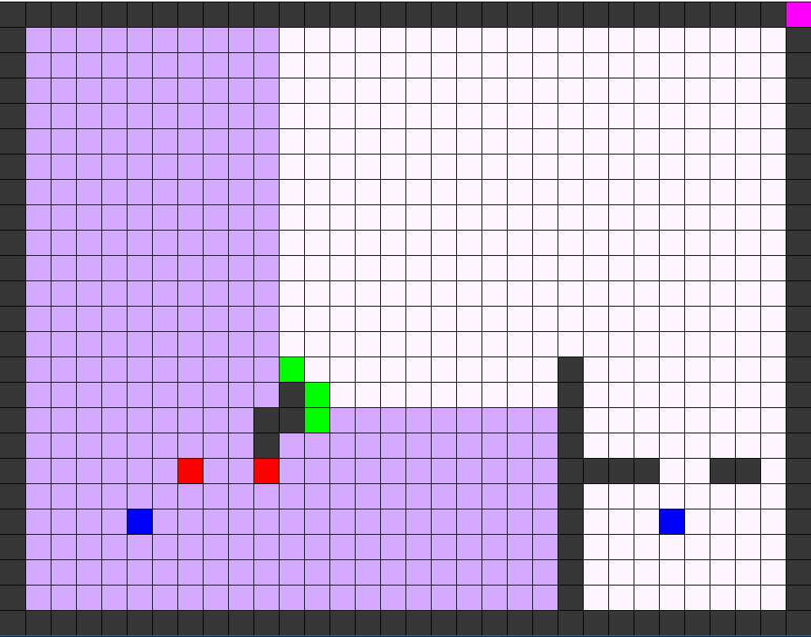
Debugging
F1 – CHANGE ALGORYTHM
F2 – SHOW DEBUG TILES
F3 – TOGGLE STEP BY STEP
Z – ZOOM IN / ZOOM OUT
S - STEPS
SPACE – FAST FORWARD STEPS

Slide 47
Let’s jump into it!

Slide 48
Todo 0
Add 8 different starting nodes, with the 8 possible directions to the open list

Slide 49
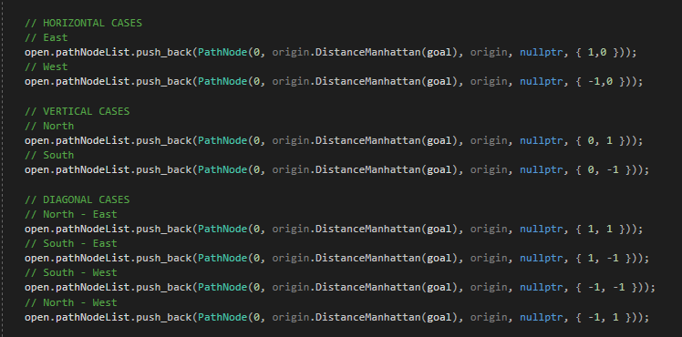
Todo 0 - Solution
Add 8 different starting nodes, with the 8 possible directions to the open list

Slide 50
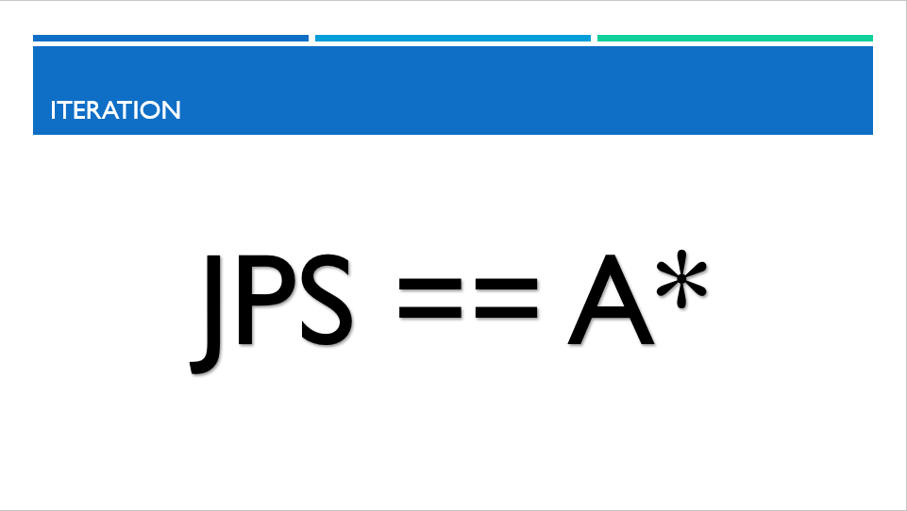
Todo 1
Fill the nieghbours list with the pruned neighbours.
Keep in mind that we do the same like in A*, only that we prune before adding elements

Slide 51
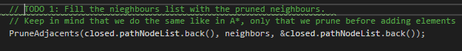
Todo 1 - Solution
Fill the nieghbours list with the pruned neighbours.
Keep in mind that we do the same like in A*, only that we prune before adding elements

Slide 52
TODO 2
Find any possible forced neighbour for an horizontal Jump. When we find one, we have to add it to the list to make sure its analyzed later on (with the proper direction), and we exit. Also, before we exit, don't forget to add the current propagation (as a node), so it can be completed and not forgotten

Slide 53
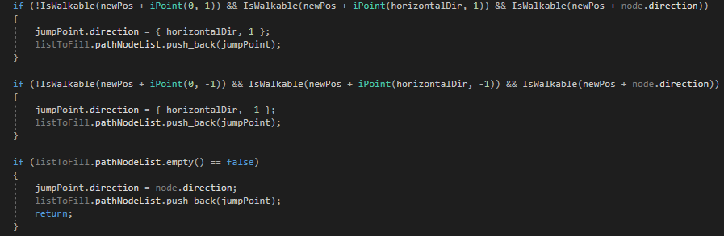
TODO 2 - Solution
Find any possible forced neighbour for an horizontal Jump. When we find one, we have to add it to the list to make sure its analyzed later on (with the proper direction), and we exit. Also, before we exit, don't forget to add the current propagation (as a node), so it can be completed and not forgotten

Slide 54
Todo 3
Really simple: if not found any forced neighbour, we just keep on jumping in the same direction as we are "coming from“. You have to make sure to return what that jump returns us

Slide 55
Todo 3
Really simple: if not found any forced neighbour, we just keep on jumping in the same direction as we are "coming from“. You have to make sure to return what that jump returns us

Slide 56
Todo 4
TODO 4: Make an horizontal jump with the proper direction. If it detected any forced neighbour, you have to add to the list the remaining directions that we are looking for (as nodes)so they don't get lost.

Slide 57
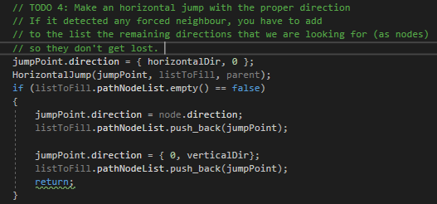
Todo 4 - solution

Slide 58
Todo 5
Make a vertical Jump with the proper direction if the Horizontal jump did not find any Jump Points. Like before, make sure to add the remaining directions.

Slide 59
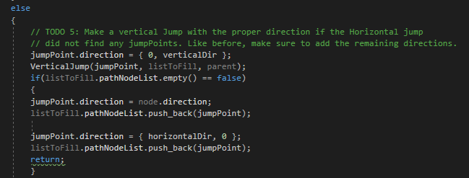
Todo 5 - solution

Slide 60
Todo 6
If none of the past two jumps returned an interesting Point, make a diagonal Jump with the same direction as this one.

Slide 61
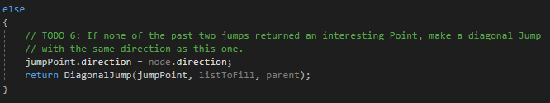
Todo 6 - Solution
If none of the past two jumps returned an interesting Point, make a diagonal Jump with the same direction as this one.

Slide 62
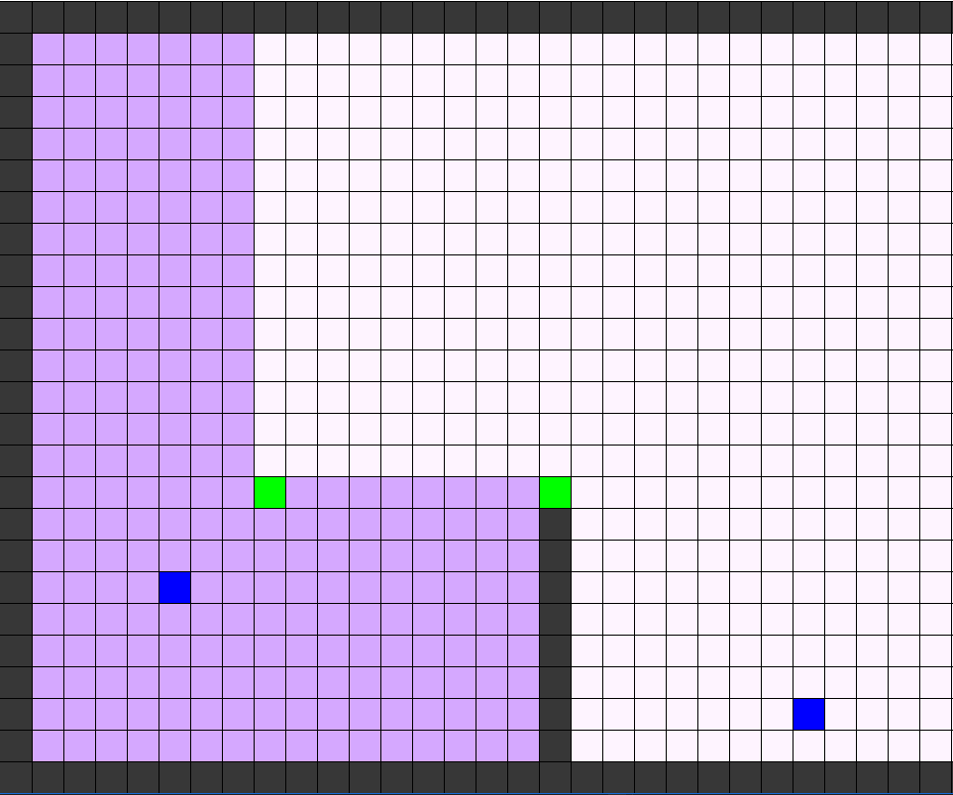
We are done!

Slide 63
Improvements

Slide 64
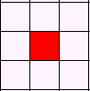
Not optimal
Each node is added multiple times to the open list
JPS handles all the pruning directions automatically

Slide 65

Missing path nodes

Slide 66
Starting loop

Slide 67
Corner traspassing

Slide 68
Thank you
sebi8818@Gmail.com
Github: Sebi-lopez

